Slide 1

Study on Construction Industry Workforce Trends

Slide 2

Who are we ?
FREE THINKERS
Team Members
Bhashitha Jagarlamudi - 16331262
2. Sai Priyatham Gummadi - 16331093
3. Swetha Namburi - 16330344
4. Muralikrishna Maanukonda - 16330766

Slide 3
Abstract
A labor-intensive industry like construction helps a nation's employment rate. The state of the nation's economy and the construction sector are closely related. The economy of the nation can be negatively impacted by a rise in the unemployment rate in the construction sector. Markets around you are no longer near you. International competition exists even in local markets as a result of globalization. Because of the potential effects on the employment rate and labor profile, changes and new trends in the construction sector must be carefully considered. The contribution of the construction sector to the US employment rate, employment trends in the sector from 2011 to 2021, and the variables affecting these changes are all included in this study.

Slide 4
Introduction
Around us, there is construction. The tenacity and sweat of construction workers are visible in the roads we travel on, the workplaces we visit, and the homes we eventually call our own as adults.
Construction is a labor-intensive business that contributes to a country's employment rate.
By examining employment statistics for the past ten years (2011-2021) in the construction sector, we are trying to derive important insights, patterns, and variables impacting these trends for our project.

Slide 5
Literature Review
M. H. Sebt, H. Rajaei, M. M. Pakseresht presented a study on construction project delays due to the weather conditions that causes high costs and risks corresponding to delay claims and their litigation.
Apurva Pamidimukkala and Sharareh Kermanshachi in a study found that construction workers had low vaccination rate, resulting in more workers getting sick, further delaying projects.
Jessica Navarro Executive Director, Communications presented an article on the impact of oil bust on the economy of Houston which led to job layoffs and unemployment over a period.
Jill Manzo, Frank Manzo IV, Robert Bruno found that 49% of all construction tasks can be automated resulting in replacement of 2.7 million construction workers and a drop of $127.5 billion construction labor income by 2057.

Slide 6
Where does the dataset come from?
Features
State | Area
Time | Total Nonfarm
Mining, Logging and Construction | Manufacturing
Information | Government
Leisure and Hospitality | Education and Health Services
Professional and Business Services | Financial Activities
Trade, Transportation and Utilities
Data is extracted from the U.S. Bureau of Labor Statistics website (https://www.bls.gov/regions/economic-summaries.htm#TX)
Metropolitan Area data : data given for a decade (2011-2021)
Constitutes 57784 observations and 13 features

Slide 7

What problem do we expect to solve with this dataset?
We are expected to analyze the employment data from the following four perspectives:
1. Seasonal variations
2. Covid Effect
3. Sudden changes in the employment numbers
4. Long term/overall trend

Slide 8
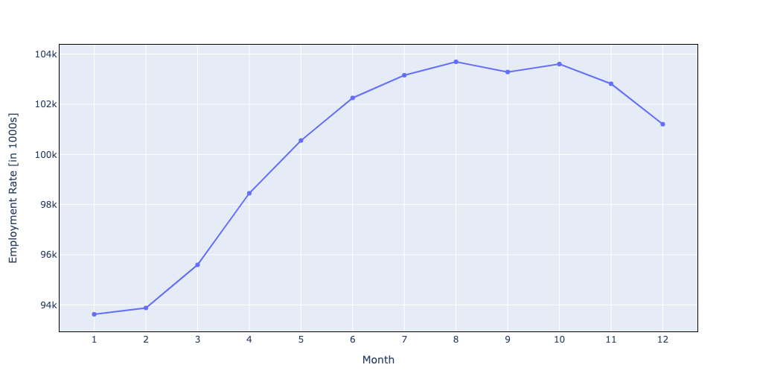
Impact of Seasonal Variations on Employment rate in the Construction Sector

Slide 9
As it relies on labor and outdoor activities, the construction industry is one of the most susceptible to bad weather conditions
Seasonal/weather events have a direct impact on the ability to accomplish construction jobs, which is often known as task feasibility. Lightning and high winds pose substantial risks to workers, slowing production or necessitating work stoppages [2]. Construction also has challenges with location, as the project is sometimes located far from home.
From figure, Up until July, we see an increase in job prospects in the construction industry, followed by three months of constant employment rates and then a decline from the middle of November to the end of the winter season (until February) as the temperature starts to drop.
This pattern might be ascribed to the unfavorable effects of the weather on the construction industry, where operations and site preparations can be severely damaged by precipitation and low temperatures rate. These weather-related factors have different effects on equipment, materials, and labor.

Slide 10
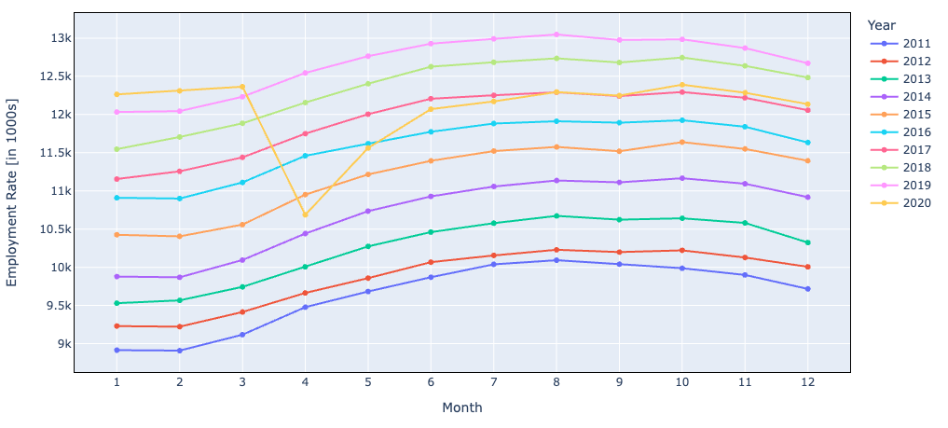
SEASONAL VARIATIONS ( Contd.)
Seasonal Employment rate for each year in the last decade

Slide 11
From the above figure the seasonal employment rate for each year from 2011 to 2020 over the last ten years.
We can see that the hiring rate peaked during the spring (March–May), summer (June–Aug), and fall (Sept–Nov) months and dropped in the winter (Dec–Feb) months between 2011 and 2019. The year 2020 followed a different pattern, with the employment rate declining in April as a result of COVID before increasing in May to reach the level of 2017. This decrease was brought on by the same factors that stopped residential building and global supply chain problems.
The next graphs shows about the highest hiring rates for construction workers are seen in metropolitan regions like Washington, New York, Chicago, and Houston, followed by Los Angeles, Boston, Dallas, and the Minneapolis Metro area.
We can observe the same general seasonal pattern continuing in these metro regions, which is a decrease in employment from December to February followed by an upward trend every month from March onward.

Slide 12
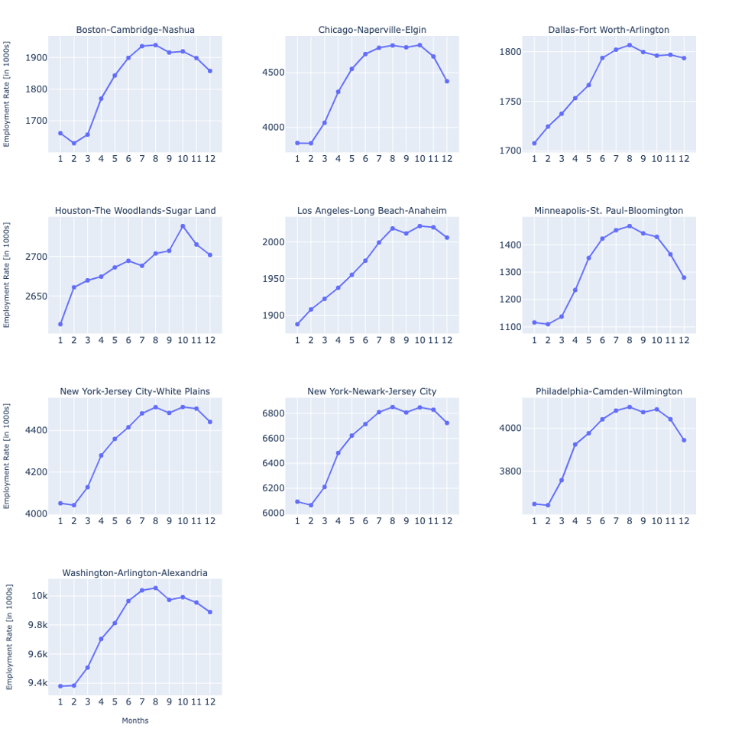
SEASONAL VARIATIONS (Contd.)
Top 10 Metro areas with Construction employees in US

Slide 13
Covid-19 and its Impact on Employment Trends in the Construction Sector
Covid-19 has had a massive impact on just about everything, personal lifestyles, social and workplace regulations, etc. The construction sector, amongst other sectors, was drastically affected in many ways by the Covid-19 pandemic.
To better understand the trend, the employment data for all states across the time period of 2011 to 2021 is plotted in Figure 6. Upon analyzing the plot, a general trend can be observed.
There is a gradual increase followed by a decrease in employment jobs throughout each year, corresponding to seasonal variations. This trend is repeated throughout the years with a gradual increase in overall employment until 2019.
In 2020, the year Covid-19 was declared a pandemic, January, February and March seem to follow the trend with an increase in employment numbers. However, there is a dramatic dip in April, 2020. The months after April seem to follow a similar seasonal variation pattern as observed previously, except there is an overall decrease in employment numbers in comparison to the years before 2020.

Slide 14
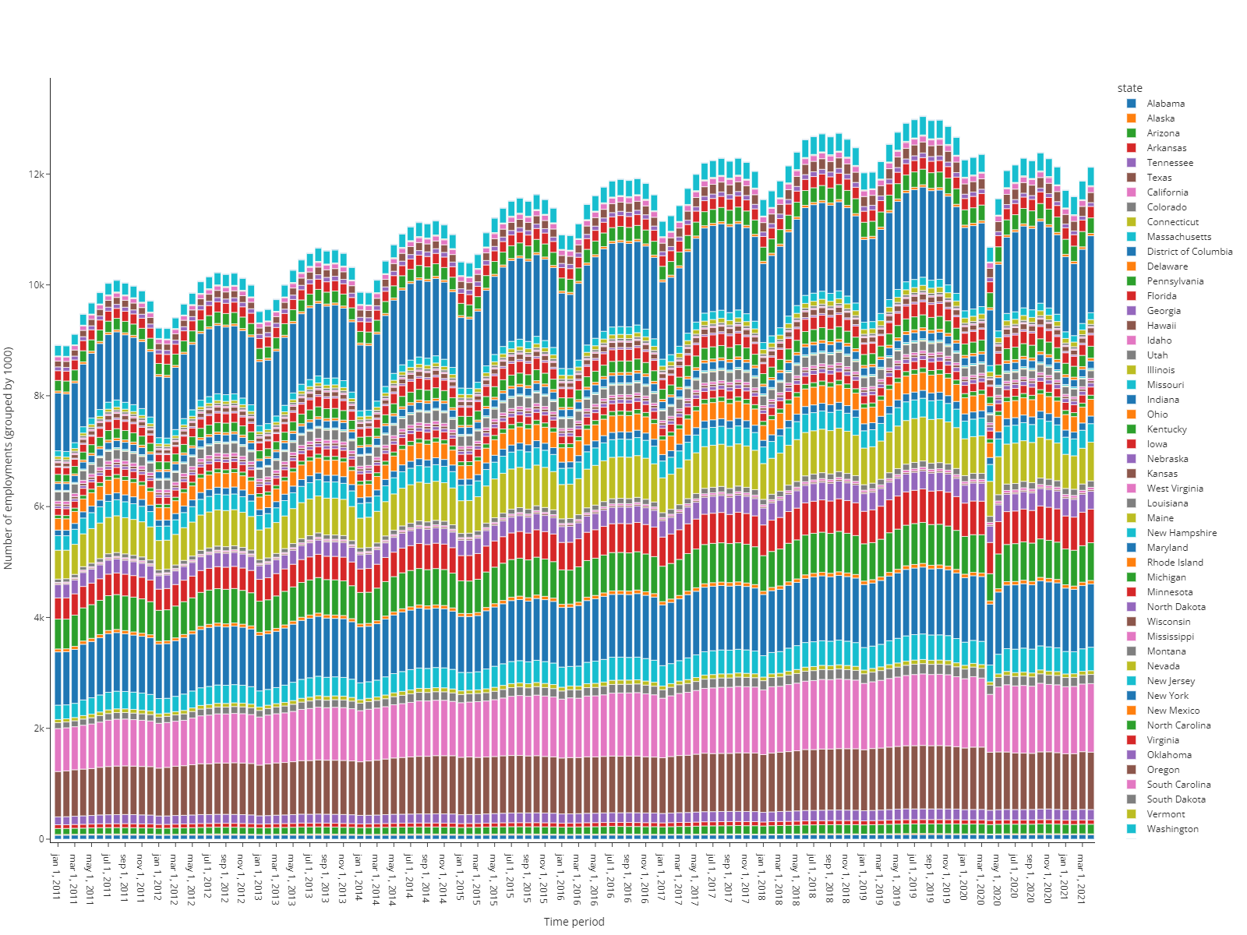
Covid EFFECT
Employment trends in construction sector across all US states and D.C. (2011 - 2021)

Slide 15
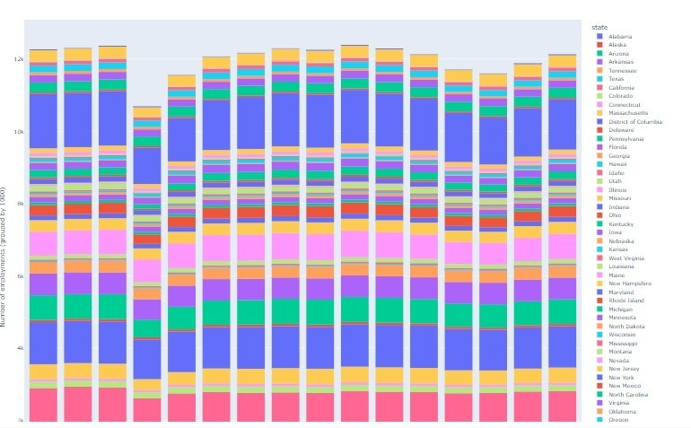
Employment in the Construction Sector across US States and D.C. During the Pandemic: A Closer Look

Slide 16
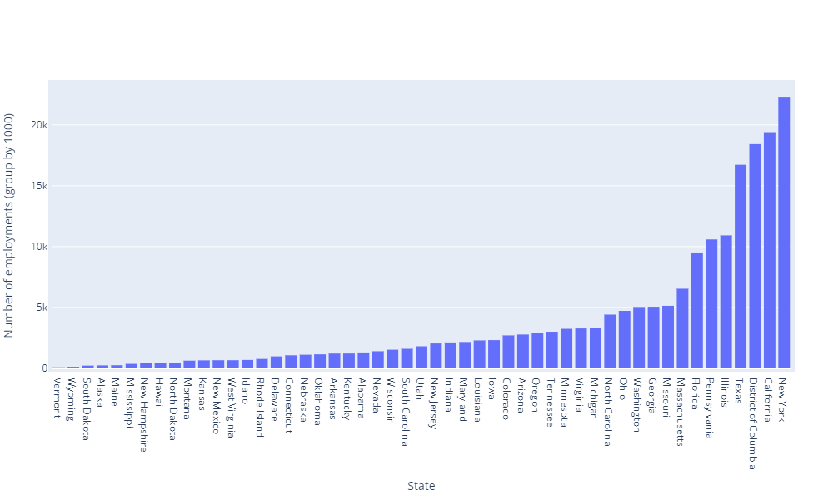
Covid EFFECT (Contd.)
US states employment contribution (ordered) to construction sector during Covid-19 pandemic (2020 - 2021)

Slide 17
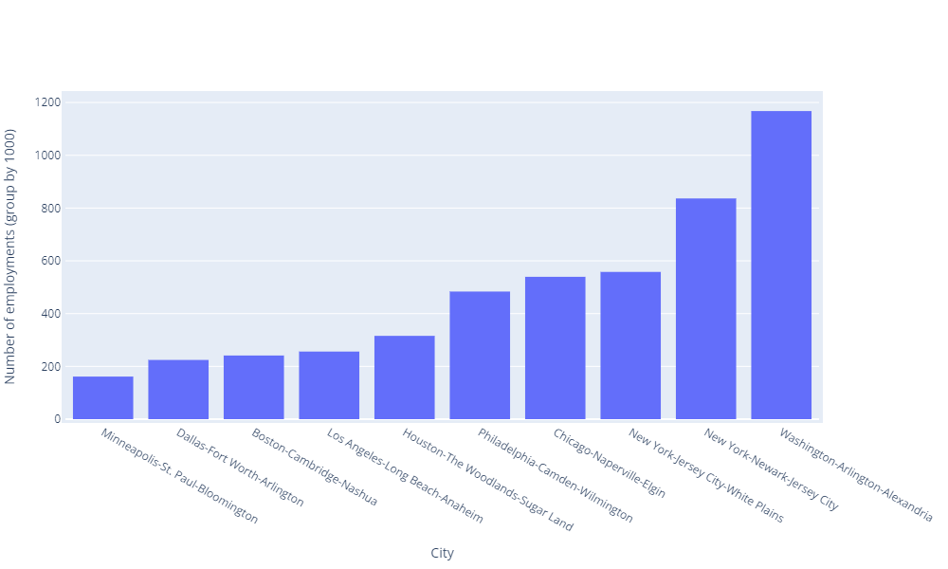
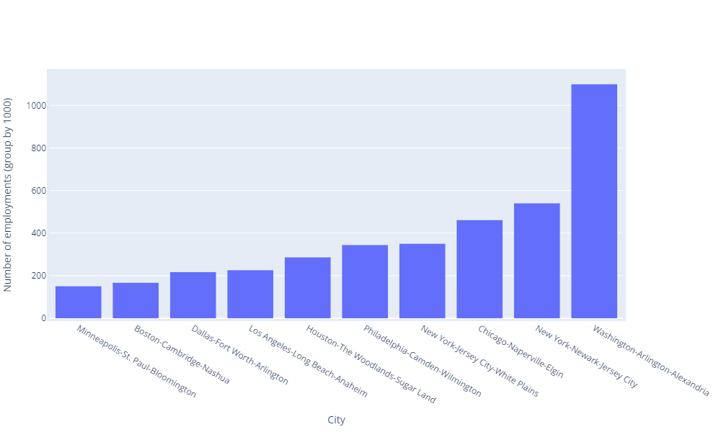
Covid EFFECT (Contd.)
Top 10 cities with highest construction jobs in April 2019 (pre-covid)
Top 10 cities with highest construction jobs in April 2020 (during covid)
Comparison of employment numbers in top 10 cities pre-covid and during covid

Slide 18
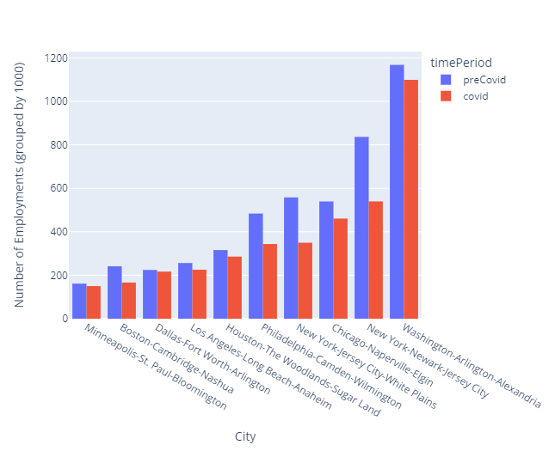
Covid EFFECT (Contd.)
The first Figure displays the top 10 cities with the highest construction employment numbers during April 2019. The second one displays the top 10 cities with the highest construction employment numbers during April 2020.
While the top cities in both categories remain the same, it can be observed that there is a shift in
Ranking.
The last one is illustrates a side by side comparison of each of the top 10 cities’ employment numbers during and prior to the pandemic. It can be observed that New York-Jersey City-White Plains and New York-Newark-Jersey City show a significant drop in construction employment numbers between the two time periods.

Slide 19

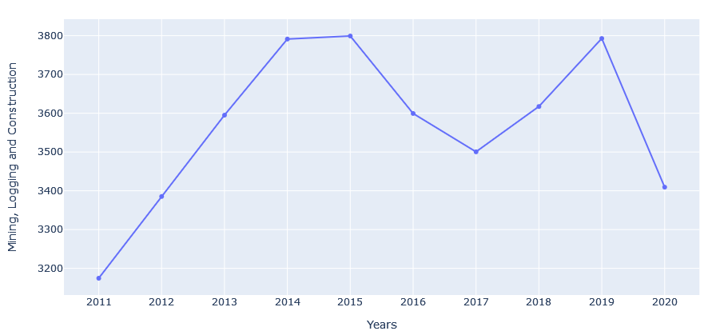
Sudden changes in the employment numbers
Total number of employees in Houston over years

Slide 20
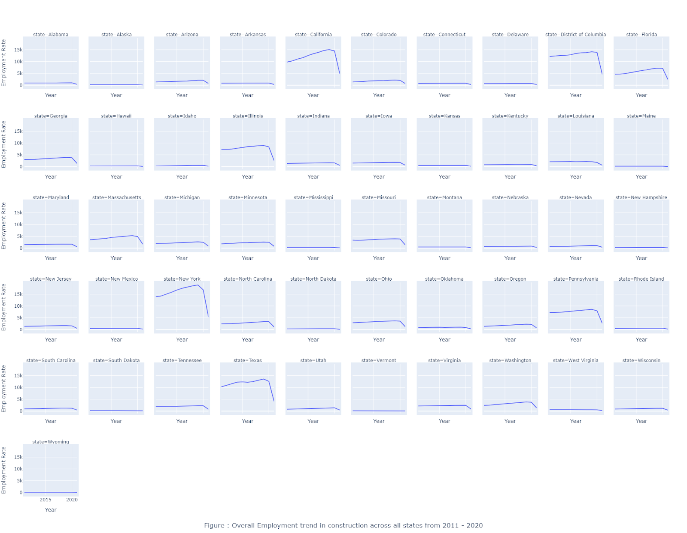
Overall / LONG-TERM TREND
Overall Employment trend in construction sector across all states (2011-2020)

Slide 21
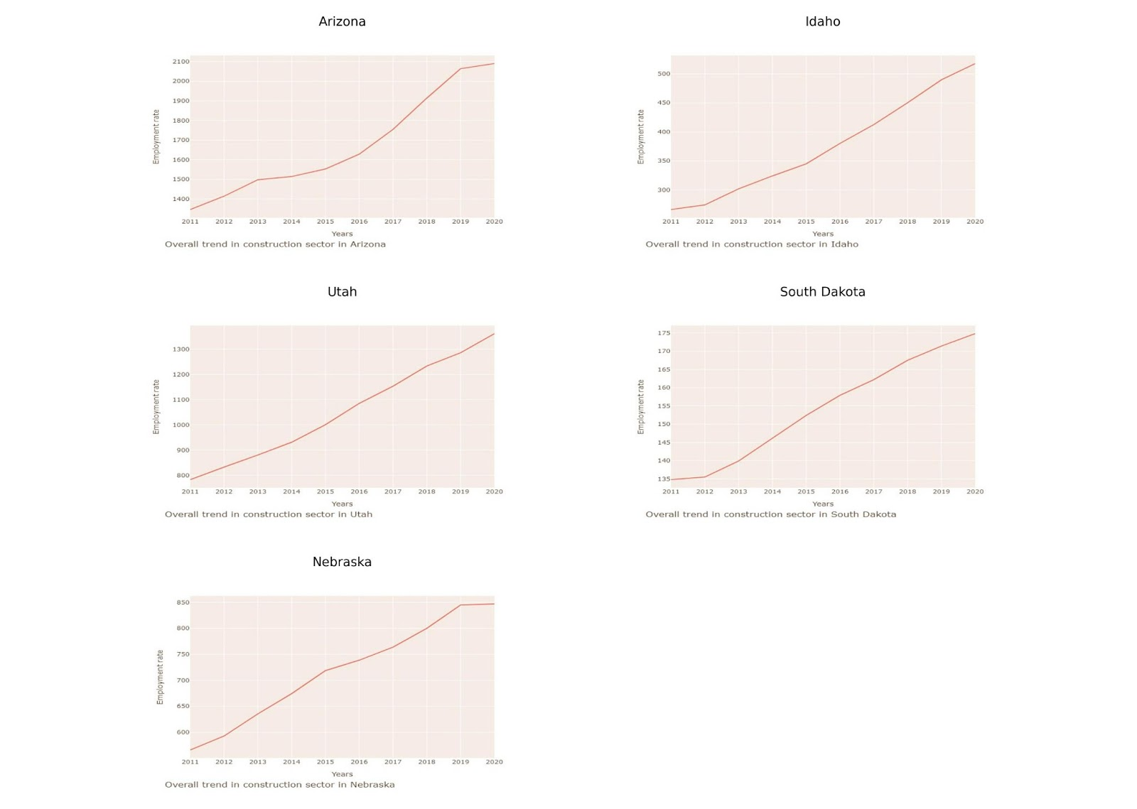
Overall / LONG-TERM TREND (Contd.)
Overall trend of the states that shows increase in employment sector over time period (2019 - 2020)

Slide 22
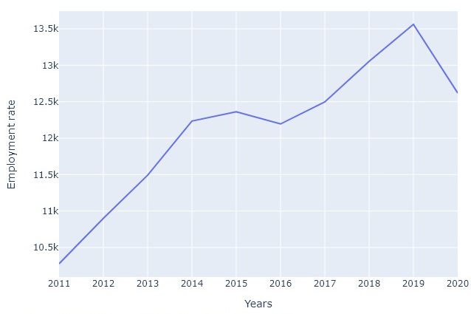
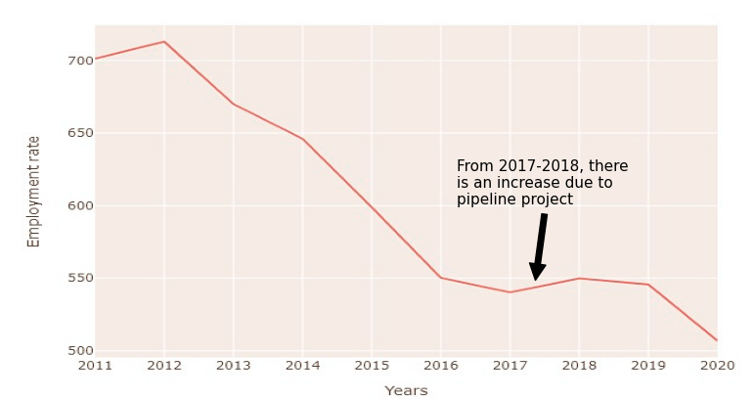
Overall / LONG-TERM TREND (Contd.)
Overall trend in employment rate for the state of Texas in the construction sector over the time period 2011 - 2020
Overall trend in employment rate for the state of the state of West Virginia in the construction sector over the time period 2011 - 2020

Slide 23
CONCLUSION
Seasonal Variations Upward trend in the rate of construction jobs in the fall and summer months and a drop or downward trend during the months of winter. The employment topped in the years 2011 and 2019 compared to all other seasons.
Covid Effect Dramatic dip in employment numbers was observed in April 2020 due to the introduction of stringent regulations to prevent the spread of the covid-19 virus. No effect of pandemic in states like Arizona, Idaho, Utah, South Dakota, Nebraska.
Sudden Changes Unemployment and loss of construction jobs observed in Houston(Texas) during great oil bust of 2015 – 2016 Between the years October 2018 – 19, the recovery from Hurricane, a substantial growth of construction jobs was noticed, lading to highest employment in the year 2019.
Overall / Long-term Trend Constant decrease in the employment rates except for the time frame 2017-18 in West Virginia due to recession in the state. Sudden increase in the employment numbers during 2017-18 due to start of a new pipeline project. Best states with construction jobs – New York, Massachusetts, Pennsylvania, Florida, Texas, Illinois, California and Georgia.

Slide 24
Thank you!

